Slide 1
List of Projects & Instructions for Machine Learning in Mechanics (APL 405) Jan-April 2022

Slide 2
Instructions
A team should have 5 members.
Every individual needs to contribute to the project.
All the project presentations need to use the template provided.
Evaluation of the projects:
Individuals need to highlight their contribution.
A minimum of 15 page project report is mandatory for the evaluation.
15 minutes presentation + 5 minutes Q&A session.
Mark Distribution (will be scaled accordingly)
Will update soon.

Slide 3
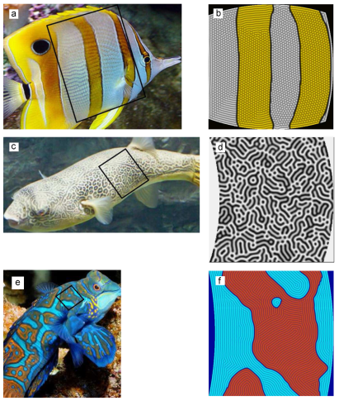
Project 1
Title: Pattern recognition in marine animals
Aim: To develop a PINN PDE discovery of mechanochemical models in identifying biological patterns of marine animals.
Resources: A new mechanochemical model: Coupled Ginzburg–Landau and Swift–Hohenberg equations in biological patterns of marine animals
Data Sets: Available in the resources.
Mentor :Saswath Ghosh
Mentees : Group 1

Slide 4
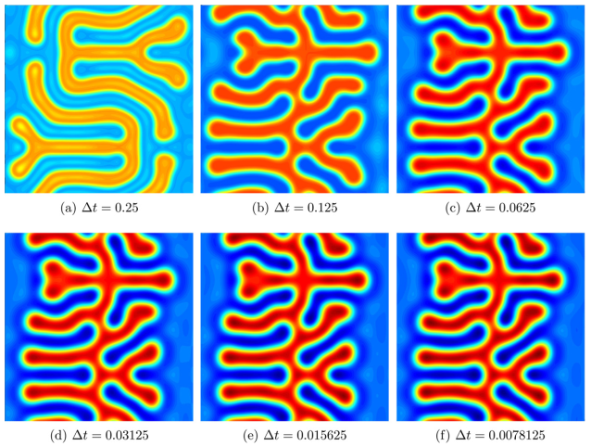
Project 2
Title: Swift–Hohenberg equation using PINN (N)
Aim: To solve Swift–Hohenberg equation within the framework of PINN.
Resources: A new space–time discretization for the Swift–Hohenberg equation that strictly respects the Lyapunov functional
Data Sets: Available in the resources.
Mentor : Sujash
Mentees : Group 2

Slide 5
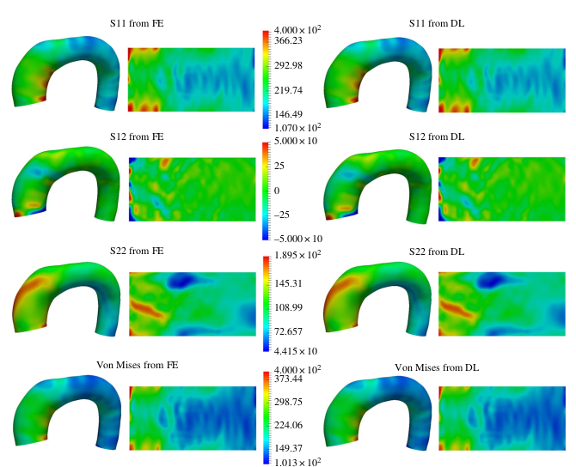
Project 3
Title: Patient-specific estimation of the stress distributions of the aorta
Aim: To develop a deep learning framework for a patient-specific estimation of the stress distributions of the aorta
Resources: A deep learning approach to estimate stress distribution: a fast and accurate surrogate of finite-element analysis
Data Sets: Link to Data
Mentor : Abhilash Awasthi
Mentees : Group 3

Slide 6
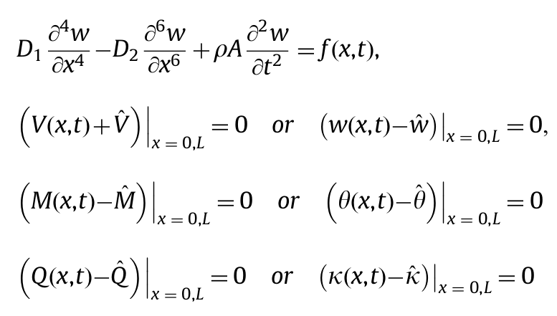
Project 4
Title: Deep learning in strain gradient elasticity
Aim: To develop a PINN solver for strain gradient Euler Bernoulli Beam.
Resources: Strain gradient beam element
Data Sets: Available in the resources
Mentor : Rajnish, Sujash
Mentees : Group 4

Slide 7
Project 5
Title: Application of Deep Learning in bioheat transfer
Aim: To develop a PINN framework for modeling bioheat transfer in the layered skin
Resources: A high -order finite difference method for solving bioheat transfer equations in three-dimensional triple -layered skin structure
Data Sets: Available in the resources
Mentor : Dina
Mentees : Group 5

Slide 8
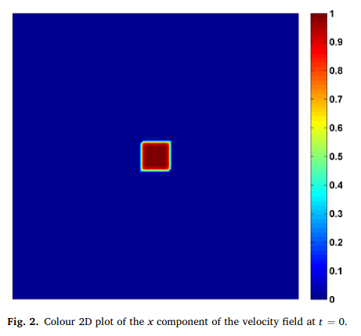
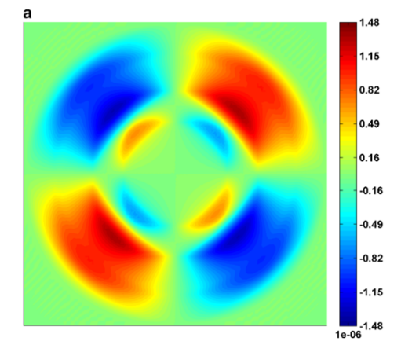
Project 6
Title: Wave propagation in elastic media
Aim: To develop a deep learning technique to simulate wave propagation in elastic media.
Resources: An analytical benchmark for a 2D problem of elastic wave propagation in a solid
Data Sets: Available in the resources.
Mentor : Amar
Mentees : Group 6

Slide 9
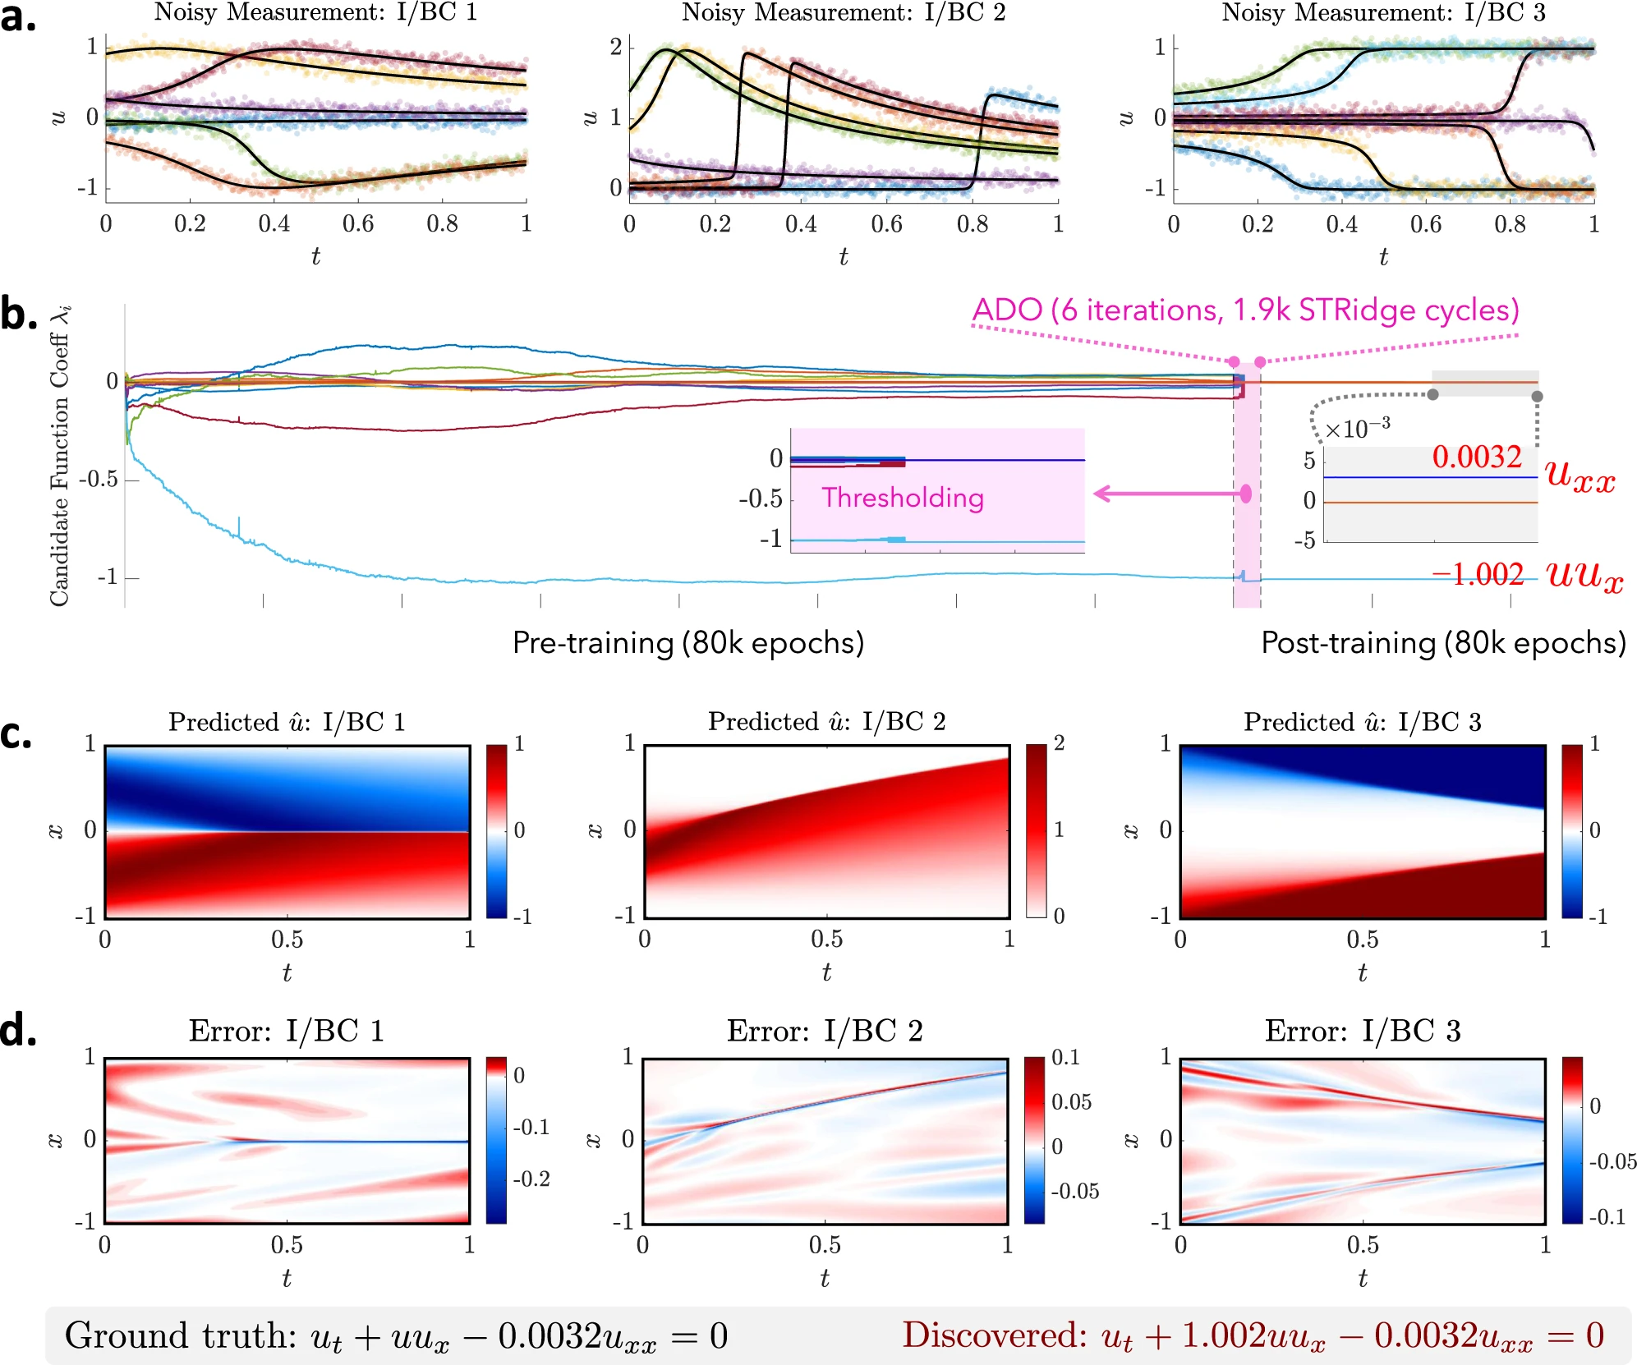
Project 7
Title: PINN for physical system with scarce data
Aim: To develop a PINN framework for solving physical system with scarce data.
Resources: Physics-informed learning of governing equations from scarce data
Data Sets: Link to data
Mentor : Debjit Hore
Supplementary: DeepMoD: Deep learning for Model Discovery in noisy data | Papers With Code
Supplementary Data: PhIMaL/DeePyMoD (github.com);
PhIMaL/DeePyMoD_torch: Pytorch implementation of the DeepMoD algorithm: [arXiv:1904.09406] (github.com)
Mentees : Group 7

Slide 10
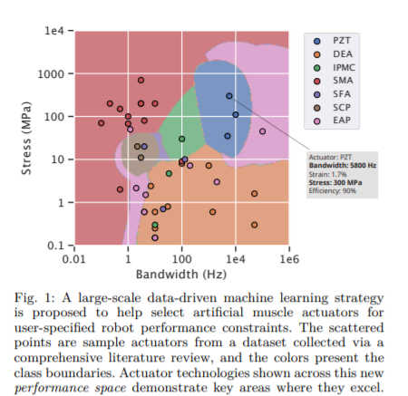
Project 8
Title: Data Driven Selection of Artificial Muscle
Aim: Classification of soft actuators based on different parameters (like stress, strain, strain rate, etc.) using SVM.
Resources: https://arxiv.org/pdf/2104.07168.pdf
Data Sets: http://robotmuscletoolkit.herokuapp.com/references
Mentor : Saswath Ghosh
Mentees : Group 8

Slide 11
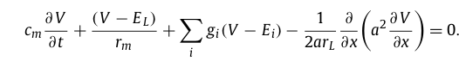
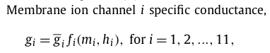
Project 9
Title: PINN for solving compartmental Hodgkin-Huxley equations
Aim: To develop an PINN based algorithm to solve compartmental Hodgkin-Huxley equations
Resources: A comparison of six numerical methods for integrating a compartmental Hodgkin-Huxley type model
Data Sets: Available in the resources
Mentor : Abhilash Awasthi
Mentees : Group 9

Slide 12
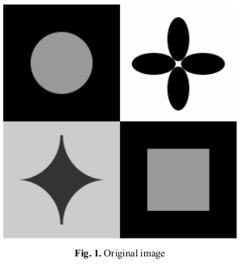
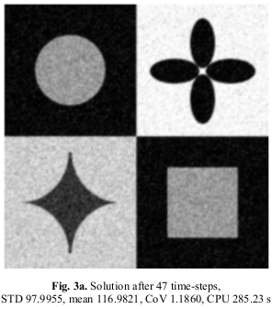
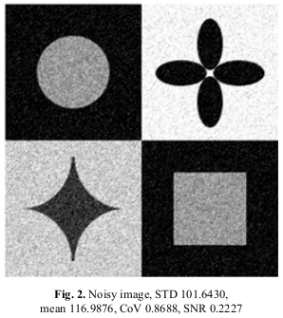
Project 10
Title: PINN in Image Processing
Aim: To develop a PINN algorithm for solving nonlinear diffusion equation and its application in image processing
Resources:
Perona-Malik equation and its numerical properties
Adaptive Finite Element Method for Image Processing
A least squares support vector regression for anisotropic diffusion filtering
Data Sets: Available in the resources
Mentor : Dina
Mentees : Group 10

Slide 13
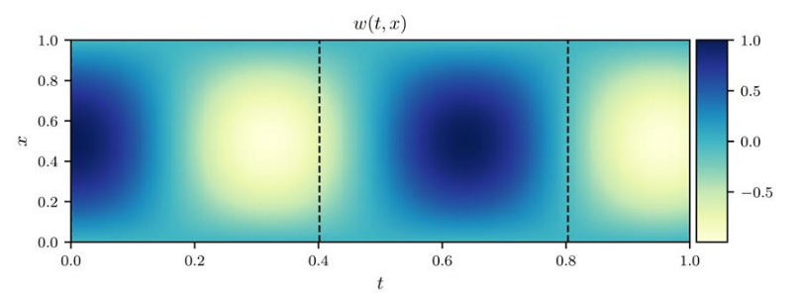
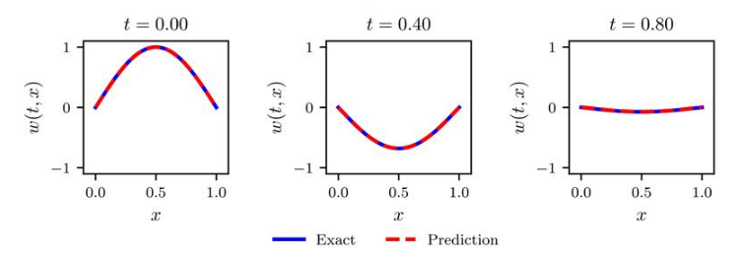
Project 11
Title: Transient dynamics of beams
Aim: To develop a Physics Informed Learning to model transient dynamics beam structures.
Resources: Physics Informed Learning for Dynamic Modeling of Beam Structures.
Data Sets: Available in the resources
Mentor : Saikat Pal
Mentees : Group 11

Slide 14
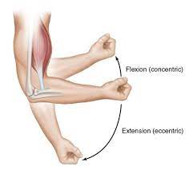
Project 12
Title: Elbow joint torque estimation using ANN/CNN
Aim: Muscles sEMG signals and Joint angle as input and elbow joint torque is output
Resources:
Data Sets:
Mentor : Rajnish, Sujash
Mentees : Group 12

Slide 15
Project 13
Title: Deep learning for solidification
Aim: To develop a physics informed learning model for one dimensional solidification using phase-field
Resources: Simulation of a one-dimensional phase-field model for solidification
Data Sets: Available in the resources
Mentor : Sujash
Mentees : Group 13

Slide 16
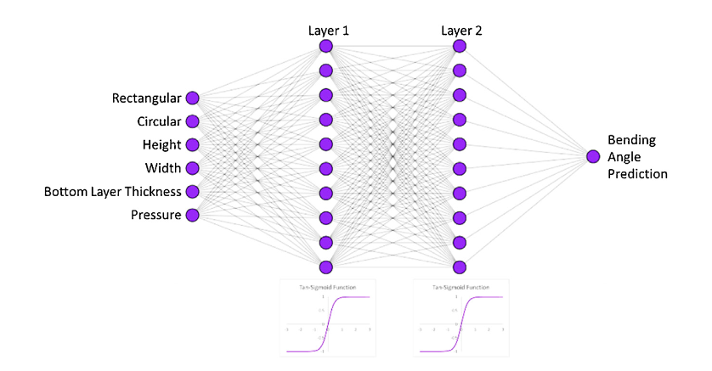
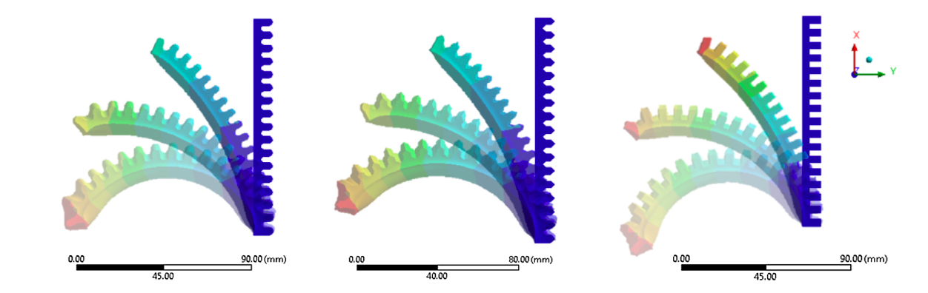
Project 14
Title: 4D printing soft robots guided by machine learning and finite element models.
Aim: This work aims to develop a ML and FE driven model that can accurately estimate the 4D printed soft pneumatic actuator(SPA) requirements to achieve a specific bending angle.
Resources: 4D printing soft robots guided by machine learning and finite element models - ScienceDirect
Bending angle prediction and control of soft pneumatic actuators with embedded flex sensors – A data-driven approach | Elsevier Enhanced Reader
A framework for the automated design and modelling of soft robotic systems.pdf
Data Sets: FEM will be used to generate datasets for a SPA using an automated MATLAB routine. {https://github.com/sivakar94/Forward_Kinematics_soft_robot#method}
Mentor : Debjit Hore
Mentees : Group 15

